Slide 1

DatA RELATED to THE DISCONTENT?
The book “Angrynomics” looked at political discontent due to economic inequality. The proposed research involves the data analysis of inequality and health (life expectancy). The solutions will likely be politically difficult to achieve.
The question that is raised? How much is income a factor in life expectancy compared to other in an area where people reside?
Notes:
*The bottom line is that before-tax income inequality has risen since the 1970s, despite an increase in government transfer payments. Because high-income people pay higher average tax rates than others, federal taxes reduce inequality. But the mitigating effect of taxes is about the same today as before 1980. Thus, after-tax income inequality has increased about as much as before-tax inequality. Taxes have not exacerbated increasing income inequality, but have not done much to offset it.- Brookings Institute

Slide 2


The Impetus Behind The Inquiry
This is research is based on political economy which is an area of study
The people I deployed with and their families voted for political extremes (Trump, Sanders) and not moderate candidates. Why are moderates politically less viable candidates?
Notes:
omic philosophy were often termed Single Taxers for their political goal of raising public revenue mainly or only from a land value tax, although

Slide 3
Data Sources
The Congressional Budget Office (CBO) . The Distribution of Household Income, 2017. https://www.cbo.gov/system/files/2020-10/56575-Household-Income.pdf
The St. Louis Federal Reserve Bank. Federal Reserve Economic Data. Median Net Worth by Income Percentile. https://fred.stlouisfed.org/series/WFRBSB50215
Raj Chetty, PhD1; Michael Stepner, BA2; Sarah Abraham, BA2; et al. The Association Between Income and Life Expectancy in the United States, 2001-2014. https://jamanetwork.com/journals/jama/article-abstract/2513561?utm_campaign=articlePDF&utm_medium=articlePDFlink&utm_source=articlePDF&utm_content=jama.2019.16932
Harvard University. Opportunity Insight Project. Income and Life Expectancy: National Life Expectancy Estimates by Gender and Income Percentile. https://opportunityinsights.org/data/
Harvard University. Opportunity Insight Project. Neighborhood Characteristics by Census Tract. https://opportunityinsights.org/data/

Slide 4
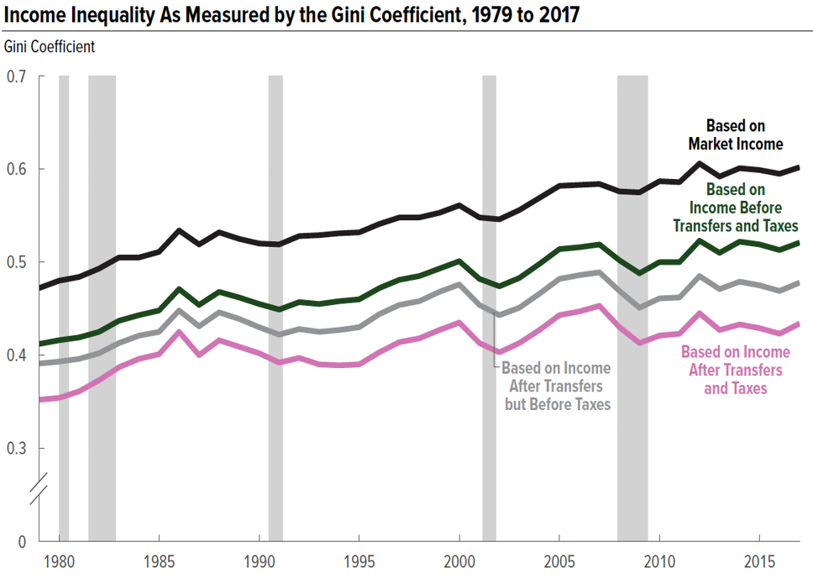
Notes:
**The data does not factor In Trump tax plan and economic impacts of COVID-19 pandemic

Slide 5
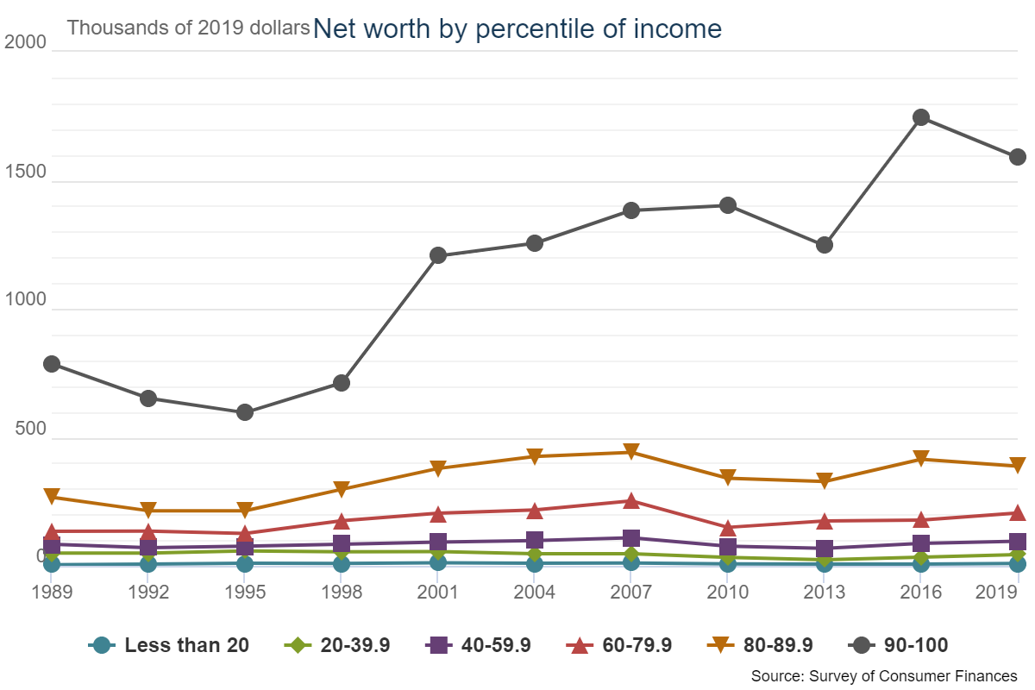
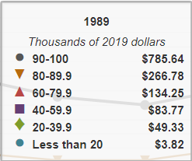
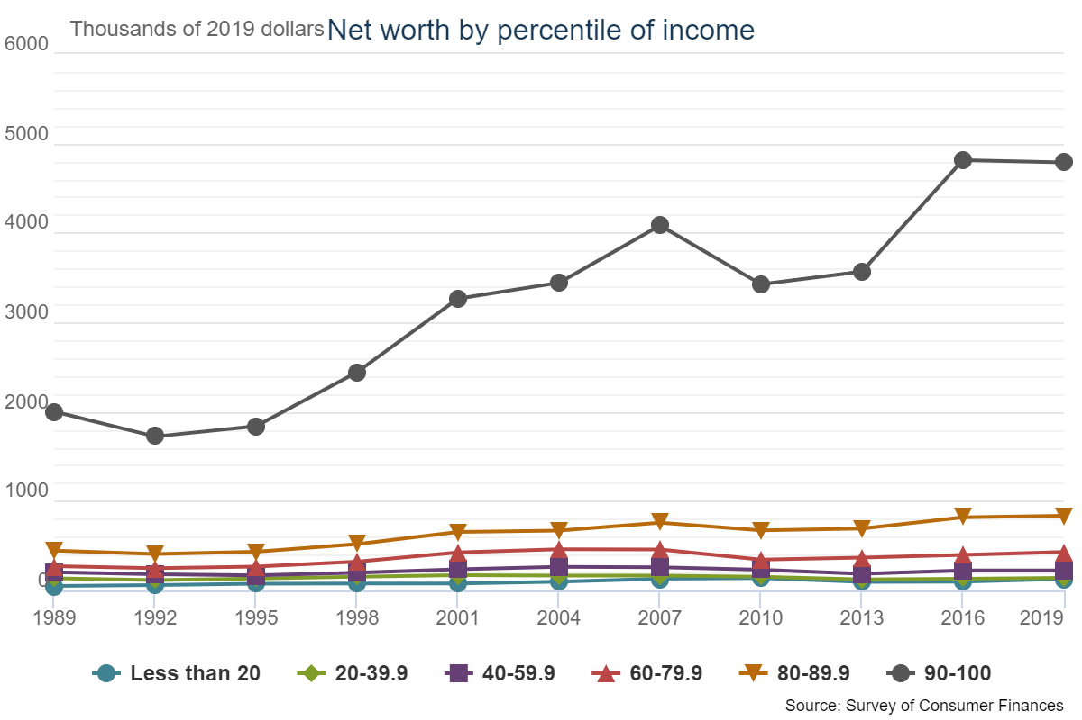
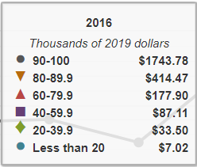
Notes:
From the Federal Reserve Economic Data- Median Net Worth by Income Percentile

Slide 6
Association Between Income and Life Expectancy for 40 Year Old Americans in 2001-2014
90
85
Expected Age at Death for 40 Year Olds in Years
80
75
Women, Bottom 1%: 78.8
Women, Top 1%: 88.9
Men, Bottom 1%: 72.7
70
Men, Top 1%: 87.3
0
20
40
60
80
100
Household Income Percentile
Notes:
**Before COVID-19 pandemic but also during Opioid crisis
**Based on JAMA data
**Time series data
####Use Different quintiles at specific years and life expectancy.

Slide 7
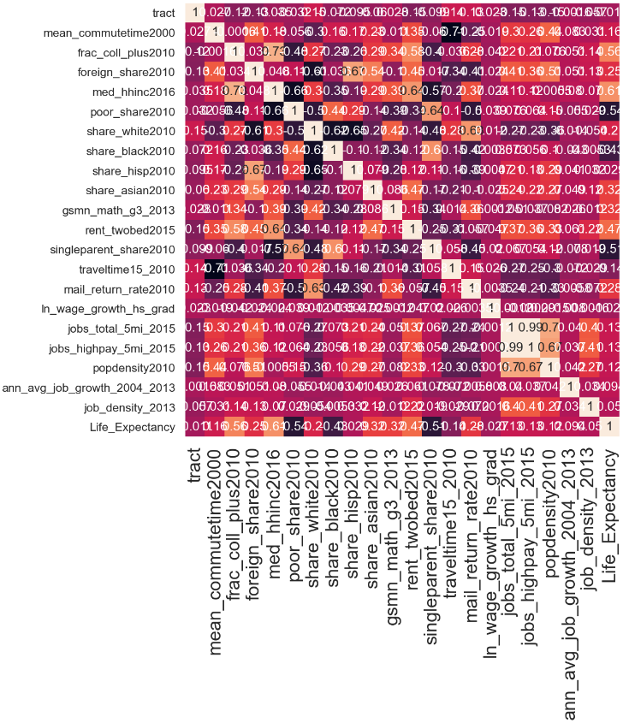
EDA Methods- Correlation Graph
Correlation Heat Map indicates
0.61 positive corr with median income
0.56 positive corr with fraction of population that have college degrees
0.47 positive corr with higher rent
0.54 negative corr with fraction of population that is poor
0.51 neg corr elationwith single parent households
Notes:
Pop density note- To qualify as an urban area, the territory identified according to criteria must encompass at least 2,500 people, at least 1,500 of which reside outside institutional group quarters. The Census Bureau identifies two types of urban areas:
Urbanized Areas (UAs) of 50,000 or more people;
Urban Clusters (UCs) of at least 2,500 and less than 50,000 people.
“Rural” encompasses all population, housing, and territory not included within an urban area.

Slide 8
Models Used and Reasons
Feature engineering could have considered if there was income data for the county/ census tracts that were at granular which present features that better represent the underlying problem to the predictive models.
Advantages of the Decision Tree are that it allows for clear visualization and somewhat easy to understand, feature scaling is often required, better handle outliers. However, It generally leads to overfitting of the data which can lead to wrong predictions. In order to fit the data (even noisy data), it keeps generating new nodes and ultimately the tree becomes too complex to interpret. In this way, it loses its generalization capabilities and makes lots mistake on new untested data. There are very high chances of high variance in the output which makes it sensitive to data “noise”. If data size is large, then one single tree may grow complex and lead to overfitting.
Used random forest for decision trees whose results are inputs into a final result which can reduce overfitting without substantially increasing error due to bias. There is minimal data pre-processing that needs to be done. Random forest handles outliers by essentially separating them and indifferent to non-linear features. Random forest models are not all that interpretable; they are like black boxes. However, more computationally intensive.
Hyper-parameter tuning: The maximum depth allowed for the decision tree was 7. The maximum features allowed for the random forest was 15.
Conclusions & Limitations
Next Steps & Recommendations
Be sure you're able to explain:

Slide 9
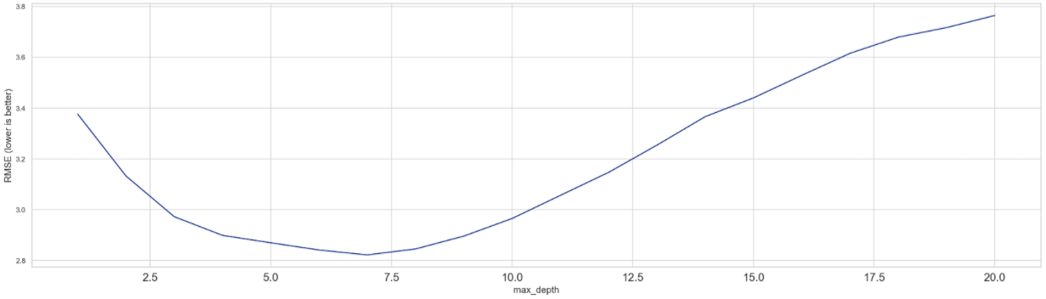
Methods- Decision Tree Model
For the Decision Tree model, 7 features based on social and economic characteristics of US counties/ census tracts were used in determining their correlation to life expectancy
feature_cols = ['tract', 'czname', 'county', 'state','frac_coll_plus2010',
'foreign_share2010', 'med_hhinc2016', 'poor_share2010’, 'singleparent_share2010','traveltime15_2010', 'ln_wage_growth_hs_grad', 'jobs_total_5mi_2015’, 'jobs_highpay_5mi_2015', 'popdensity2010',
'ann_avg_job_growth_2004_2013', 'job_density_2013']
X = abridged_df[feature_cols]
y = abridged_df.Life_Expectancy
DecisionTreeRegressor used max_depth (number of features used)=7, random_state=1)
Notes:
Pop density note- To qualify as an urban area, the territory identified according to criteria must encompass at least 2,500 people, at least 1,500 of which reside outside institutional group quarters. The Census Bureau identifies two types of urban areas:
Urbanized Areas (UAs) of 50,000 or more people;
Urban Clusters (UCs) of at least 2,500 and less than 50,000 people.
“Rural” encompasses all population, housing, and territory not included within an urban area.

Slide 10
Methods- Random Forest
For the Random Forest model, 15 features based on social and economic characteristics of US counties/tract were used in determining their correlation to life expectancy
feature_cols = ['tract', 'czname', 'county', 'state','frac_coll_plus2010’, 'foreign_share2010', 'med_hhinc2016', 'poor_share2010’, 'singleparent_share2010','traveltime15_2010', 'ln_wage_growth_hs_grad', 'jobs_total_5mi_2015’, 'jobs_highpay_5mi_2015', 'popdensity2010’, 'ann_avg_job_growth_2004_2013', 'job_density_2013']
X = abridged_df[feature_cols]
y = abridged_df.Life_Expectancy
RandomForestRegressor used max_depth (number of features used)=15, random_state=1)
* Considered Using RandomizedSearchCV which took more than 40 mins
rf = RandomForestRegressor(random_state=1)
RSclf = RandomizedSearchCV(rf,param_grid, cv=5, n_iter=10)
RSclf.fit(X,y)
Determined best parameters: 'n_estimators': 780, 'max_features': 9
Notes:
Pop density note- To qualify as an urban area, the territory identified according to criteria must encompass at least 2,500 people, at least 1,500 of which reside outside institutional group quarters. The Census Bureau identifies two types of urban areas:
Urbanized Areas (UAs) of 50,000 or more people;
Urban Clusters (UCs) of at least 2,500 and less than 50,000 people.
“Rural” encompasses all population, housing, and territory not included within an urban area.

Slide 11
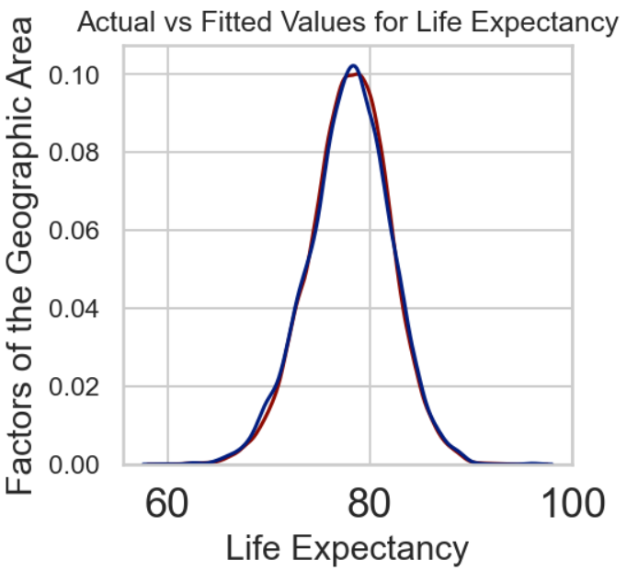
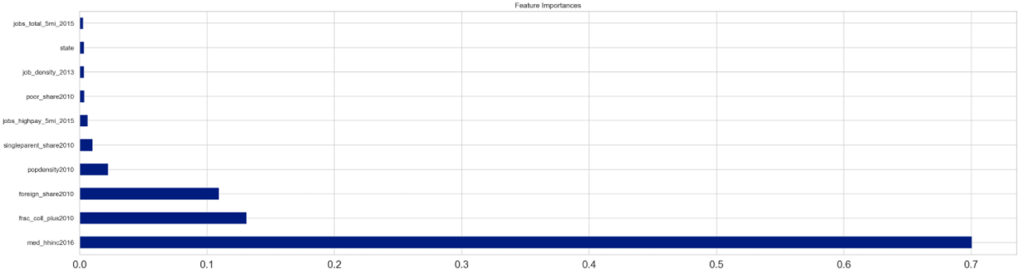
Social, Economic, and Geographic Factors in Life Expectancy (Decision Tree Analysis)
Mean Absolute Error: 2.8909933896437754
Mean Squared Error: 14.0258676092545
Root Mean Squared Error: 3.745112496208158 Accuracy: 96.28%
Feature | Importance
med_hhinc2016 (med household income): | 7.006728e-01
frac_coll_plus2010 (fraction of population college educated) | 1.311336e-01
foreign_share2010 (fraction of foreign born): | 1.094711e-01
Popdensity2010 (population per sq mile): | 2.254595e-02
singleparent_share2010 (fraction of single parent households) | 1.021012e-02
*Data Leakage from Life Expectancy and Income
Notes:
Pop density note- To qualify as an urban area, the territory identified according to criteria must encompass at least 2,500 people, at least 1,500 of which reside outside institutional group quarters. The Census Bureau identifies two types of urban areas:
Urbanized Areas (UAs) of 50,000 or more people;
Urban Clusters (UCs) of at least 2,500 and less than 50,000 people.
“Rural” encompasses all population, housing, and territory not included within an urban area.

Slide 12
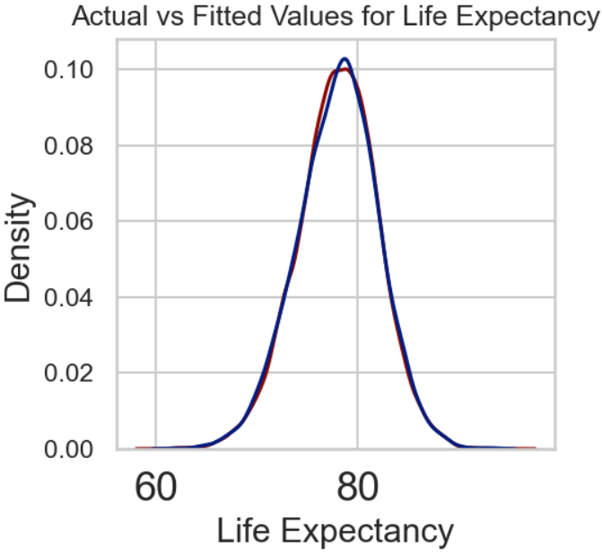
Social, Economic, and Geographic Factors in Life Expectancy (Decision Tree Analysis)
Mean Absolute Error: 2.8909933896437754
Mean Squared Error: 14.0258676092545
Root Mean Squared Error: 3.745112496208158 Accuracy: 96.28%
Feature | Importance
med_hhinc2016 (med household income): | 7.006728e-01
frac_coll_plus2010 (fraction of population college educated) | 1.311336e-01
foreign_share2010 (fraction of foreign born): | 1.094711e-01
Popdensity2010 (population per sq mile): | 2.254595e-02
singleparent_share2010 (fraction of single parent households) | 1.021012e-02
*Data Leakage from Life Expectancy and Income
Notes:
Pop density note- To qualify as an urban area, the territory identified according to criteria must encompass at least 2,500 people, at least 1,500 of which reside outside institutional group quarters. The Census Bureau identifies two types of urban areas:
Urbanized Areas (UAs) of 50,000 or more people;
Urban Clusters (UCs) of at least 2,500 and less than 50,000 people.
“Rural” encompasses all population, housing, and territory not included within an urban area.

Slide 13
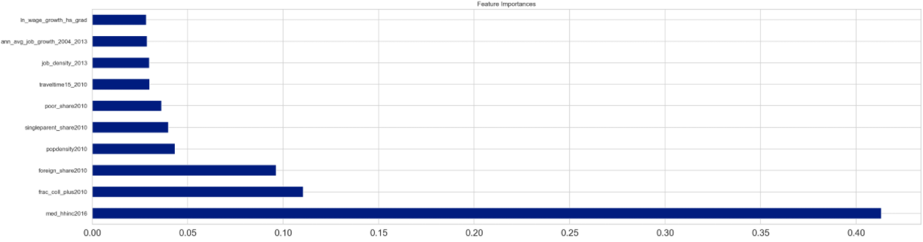
Social, Economic, and Geographic Factors in Life Expectancy (Random Forest Analysis)
Mean Absolute Error: 0.8792662774044289 Mean Squared Error: 4.276068084168778 Root Mean Squared Error: 2.067865586581676
Feature Importance
med_hhinc2016 (med household income): 0.413172
poor_share2010 (fraction of indigent in population): 0.110481
foreign_share2010 (fraction of foreign born): 0.096254
popdensity2010 (population per sq mile): 0.043347 job_density_2013 (number of jobs per sq mile): 0.039791
*Data Leakage from Life Expectancy and Income
Notes:
Use Bar chart- Sort by feature importance
Pop density note- To qualify as an urban area, the territory identified according to criteria must encompass at least 2,500 people, at least 1,500 of which reside outside institutional group quarters. The Census Bureau identifies two types of urban areas:
Urbanized Areas (UAs) of 50,000 or more people;
Urban Clusters (UCs) of at least 2,500 and less than 50,000 people.
“Rural” encompasses all population, housing, and territory not included within an urban area.

Slide 14
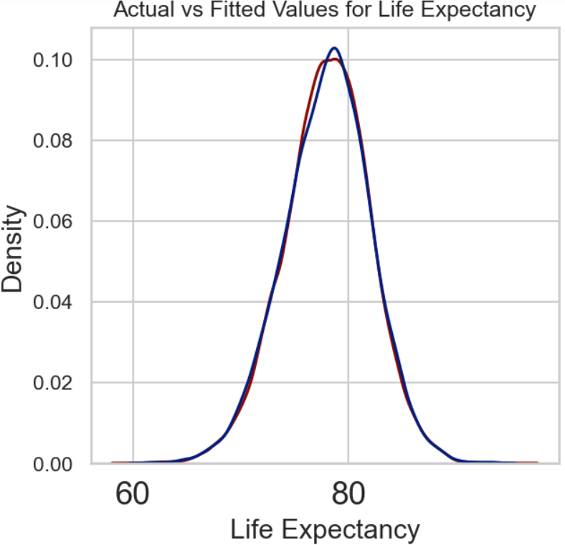
Social, Economic, and Geographic Factors in Life Expectancy (Random Forest Analysis)
Mean Absolute Error: 0.8792662774044289 Mean Squared Error: 4.276068084168778 Root Mean Squared Error: 2.067865586581676
Test Values
Mean Absolute Error: 0.8792662774044289
Mean Squared Error: 4.276068084168778
Root Mean Squared Error: 2.067865586581676 Accuracy: 98.87%
feature importance
med_hhinc2016 (med household income): 0.413172
poor_share2010 (fraction of indigent in population): 0.110481
foreign_share2010 (fraction of foreign born): 0.096254
popdensity2010 (population per sq mile): 0.043347 job_density_2013 (number of jobs per sq mile): 0.039791
*Data Leakage from Life Expectancy and Income
Notes:
Use Bar chart- Sort by feature importance
Pop density note- To qualify as an urban area, the territory identified according to criteria must encompass at least 2,500 people, at least 1,500 of which reside outside institutional group quarters. The Census Bureau identifies two types of urban areas:
Urbanized Areas (UAs) of 50,000 or more people;
Urban Clusters (UCs) of at least 2,500 and less than 50,000 people.
“Rural” encompasses all population, housing, and territory not included within an urban area.

Slide 15
Conclusions & Limitations
Income is statistically significant due to 0.41 and 0.7 correlation scores with life expectancy. But the disparity in life expectancy due to income also needs to be tied in to other factors (i.e. access to healthcare, healthier eating habits, etc.
Feature engineering could have considered if there was income data for the county/ census tracts that were at granular which present features that better represent the underlying problem to the predictive models.
The data covered 2000-2017 which did not account for the Trump Tax cuts, COVID-19 and other factors.
There are confounding or unknown factors such as health hazards (sites/sources of pollution), high crime areas, prevalence of health conditions and that were not in the data.
Conclusions & Limitations
Next Steps & Recommendations
Be sure you're able to explain:
Notes:
https://www.pewresearch.org/social-trends/2020/01/09/most-americans-say-there-is-too-much-economic-inequality-in-the-u-s-but-fewer-than-half-call-it-a-top-priority/ Pew Research Jan 2020

Slide 16
Next Steps & Recommendations
Further research could be done on how much fiscal policy can reduce or increase economic inequality can alter life expectancy.
Gather more data on life expectancy and income inequality during the COVID-19 pandemic.
Possibly more progressive fiscal policies that reduce economic inequality (politically controversial)?
Notes:
https://www.pewresearch.org/social-trends/2020/01/09/most-americans-say-there-is-too-much-economic-inequality-in-the-u-s-but-fewer-than-half-call-it-a-top-priority/ Pew Research Jan 2020

Slide 17
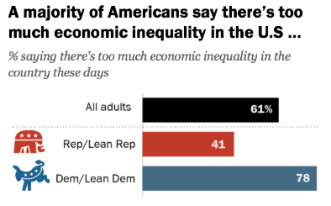
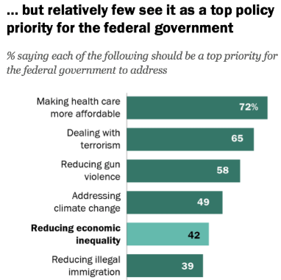
The Disconnect
Pew Research Jan 2020
Notes:
https://www.pewresearch.org/social-trends/2020/01/09/most-americans-say-there-is-too-much-economic-inequality-in-the-u-s-but-fewer-than-half-call-it-a-top-priority/ Pew Research Jan 2020

Slide 18
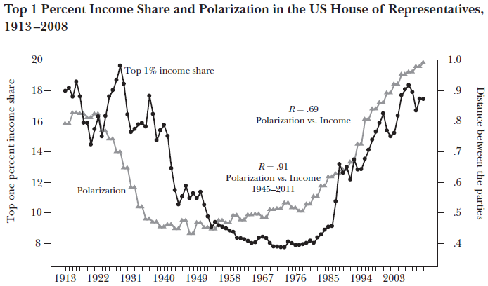
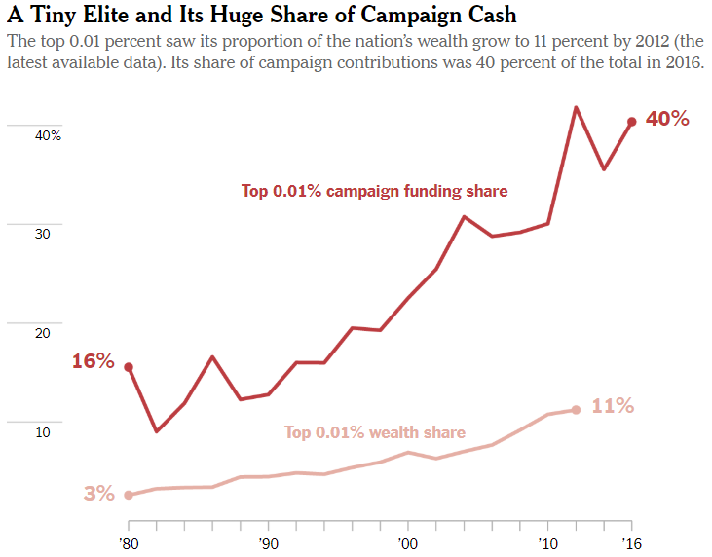
Political Solutions Seem Less Likely…
Notes:
https://www.nytimes.com/2018/02/15/opinion/democracy-inequality-thomas-piketty.html-
https://www.researchgate.net/publication/262101269 Why Hasn't Democracy Slowed Rising Inequality?
Article in Journal of Economic Perspectives · August 2013

Slide 19
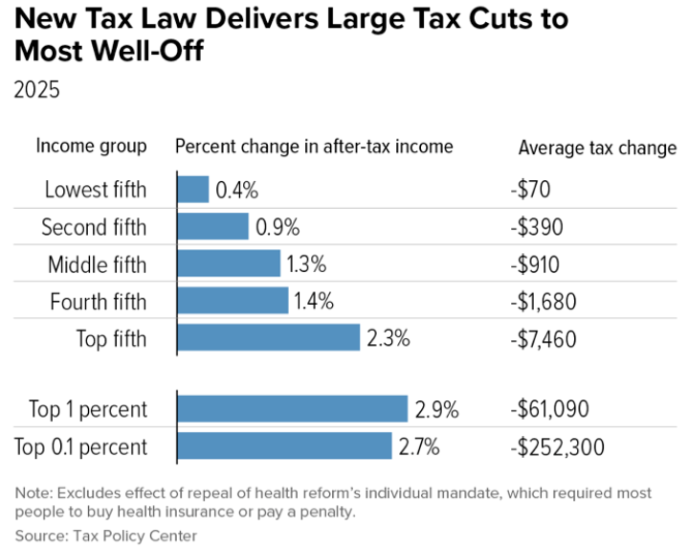
Or Dependent on Political Shifts (Right).
Tax Cuts and Jobs Act of 2017
Notes:
Fundamentally Flawed 2017 Tax Law Largely Leaves Low- and Moderate-Income Americans Behind
https://www.cbpp.org/research/federal-tax/fundamentally-flawed-2017-tax-law-largely-leaves-low-and-moderate-income

Slide 20
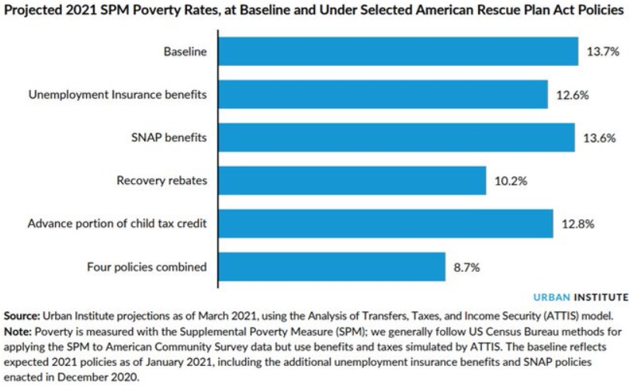
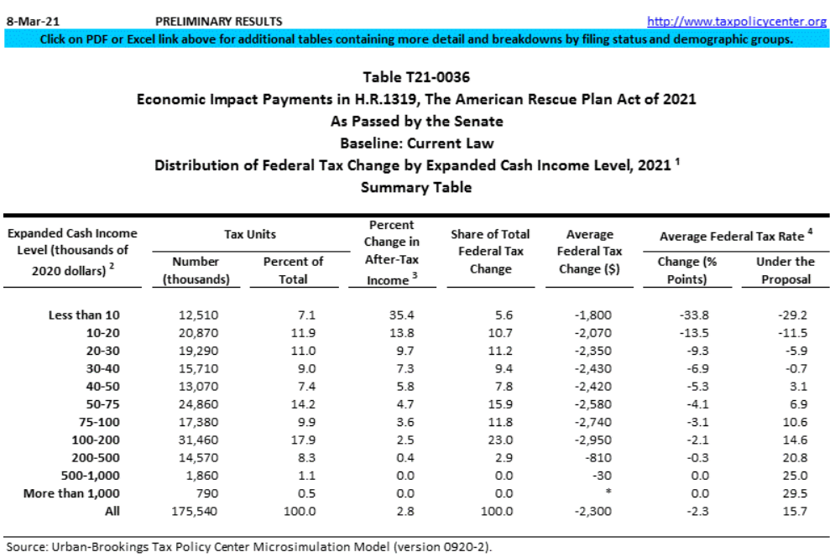
Or Dependent on Political Shifts (Left).
American Rescue Plan of 2021
Notes:
2021 Poverty Projections: Assessing Four American Rescue Plan Policies- The Urban Institute
https://twitter.com/urbaninstitute/status/1369675678308794369
**2011, the U.S. Census Bureau began publishing the Supplemental Poverty Measure (SPM), which extends the official poverty measure by taking account of many of the government programs designed to assist low-income families and individuals that are not included in the official poverty measure.

Slide 21
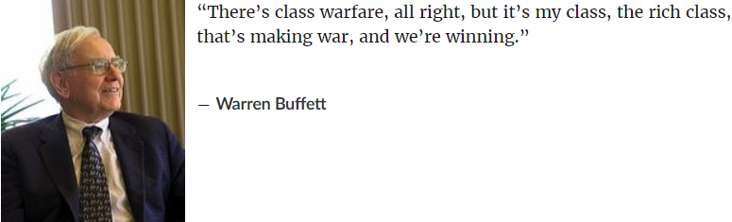
ENDING
Notes:
*The bottom line is that before-tax income inequality has risen since the 1970s, despite an increase in government transfer payments. Because high-income people pay higher average tax rates than others, federal taxes reduce inequality. But the mitigating effect of taxes is about the same today as before 1980. Thus, after-tax income inequality has increased about as much as before-tax inequality. Taxes have not exacerbated increasing income inequality, but have not done much to offset it.- Brookings Institute

